Slide 1
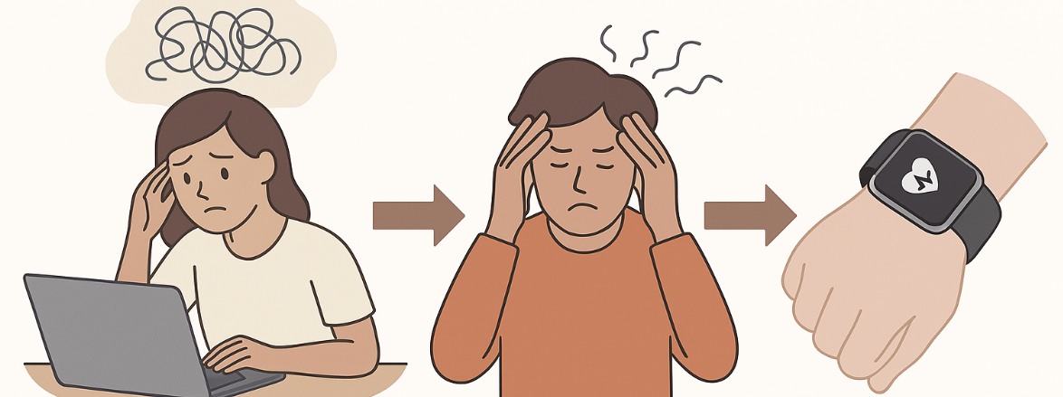
Electronic skin sensor for multimodal stress responses monitoring
Janosh Huyse (EL)
Nanotechnology – Research paper
https://doi.org/10.1038/s41928-023-01116-6
07.05.25
Notes:
So today, we will talk about a paper that succeeded at detecting stress using an electronic sensor on the skin

Slide 2
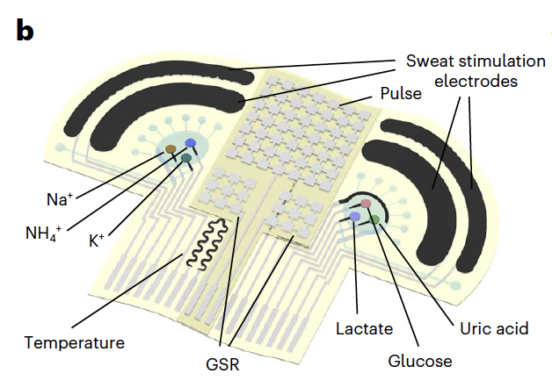
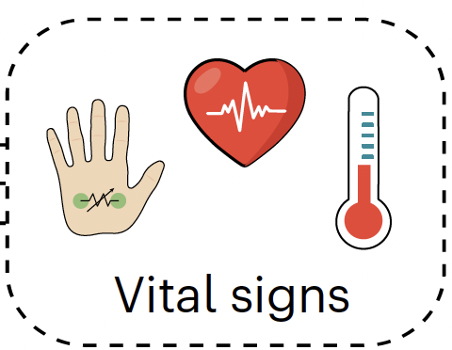
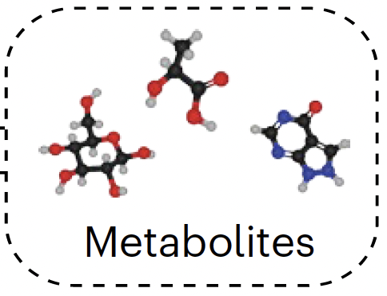
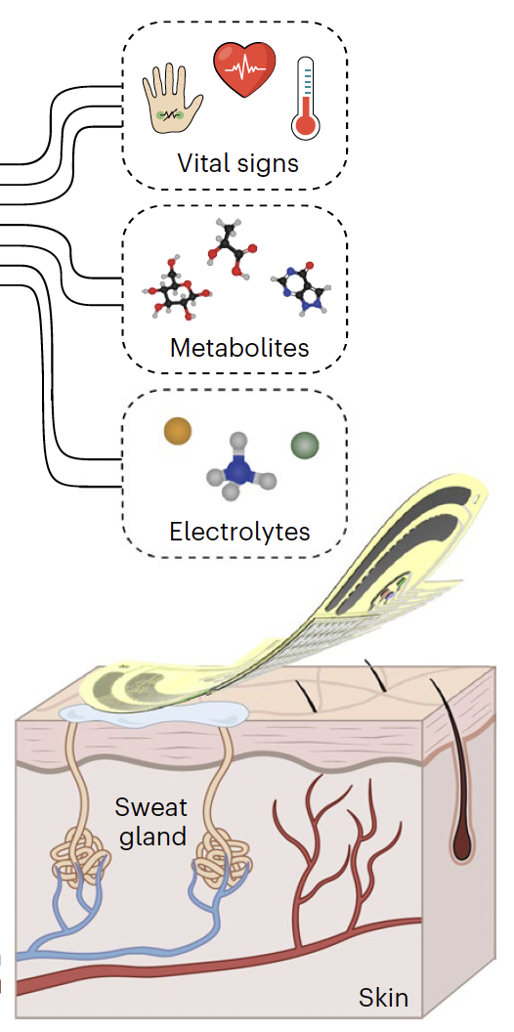
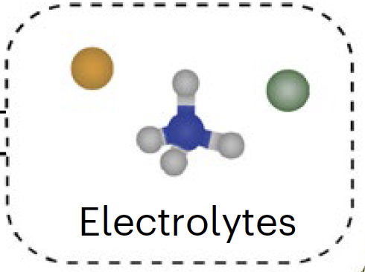
CARES (Consolidated AI-reinforced electronic skin)
Tracks 3 vital signs
  Pulse, GSR, Temperature
6 sweat biomarkers
  Glucose, Lactate, UA,
  Na+, K+, NH4+
Fig 3b
Notes:
Now this is where the Cares device comes into play
5 different biosensors:

Slide 3
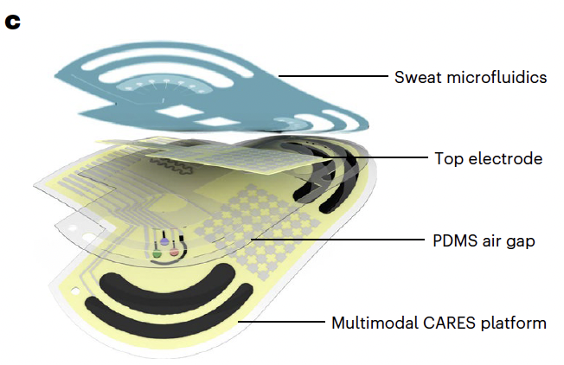

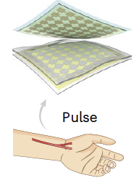
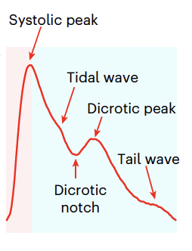

CARES device
Substrate : ultrathin flexible polyimide (PI)
Middle layer : PDMS-based airgap
→ pressure sensing
Top layer: iontophoresis (IP) module → induce sweat secretion without physical effort, collected in microfluidic module
Fig 1c, 2i
Notes:
“The CARES patch is built in layers:
a flexible polyimide substrate,
a PDMS airgap that acts as a pressure sensor to capture the pulse waveform,
and a top iontophoresis layer that induces sweat, which is collected in microfluidics.

Slide 4
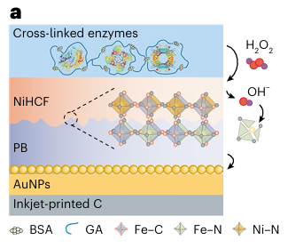
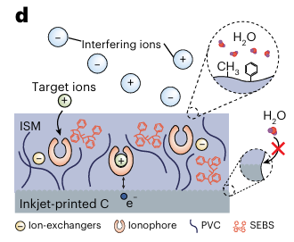
Inside the CARES biosensors
enzymatic (metabolites)
Metabolite sensors stability enhanced by adding a NiHCF protective layer → stable for 100+ hours.
ion-selective sensors enhanced with SEBS → prevents voltage drift by ionophore leaching and water formation
ion-selective (electrolytes)

Slide 5
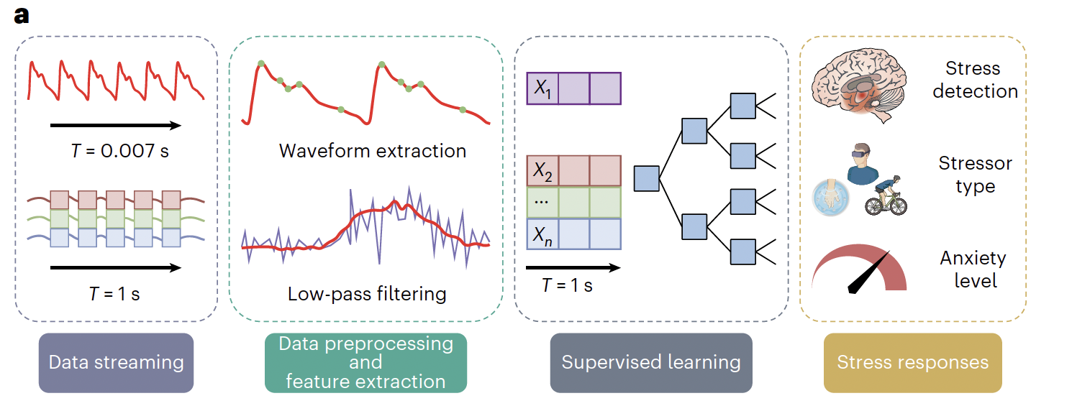
Machine Learning + Multimodal Data = Precision Monitoring
Extreme Gradient Boosting Model
(XG Boost)
99.2 %
>98.0 %
98.1%
(QS)
Real-life validation: subjects underwent
  Cold Pressor Test,
  VR stress
  Intense cycling.
Notes:
raw biosignals are extracted and filtered
aligned and compressed into useful features every 1 second
Used to train a machine learning model (like XGBoost)
The model learns to map input features (X₁…Xₙ) to outputs like stress or anxiety
XG boost - ML model --> showed best accuracy, they tested it
three ML analysises:
Stress detection: Is the person under stress or in a relaxed state?
Stressor classification: What kind of stress is it—VR, CPT, or exercise?
Anxiety level estimation: How intense is the stress? Can we predict the person’s reported anxiety score?

Slide 6
Why This Paper Deserves Attention
Strong link from stress physiology to technical sensing design.
Combines biochemistry, electronics, and data science into a real-world-ready patch.
High impact potential for mental health and performance monitoring.
Limitation: further long-term clinical testing still needed before widespread use.

